Slide 1

Data Model - Apple Store

Slide 2
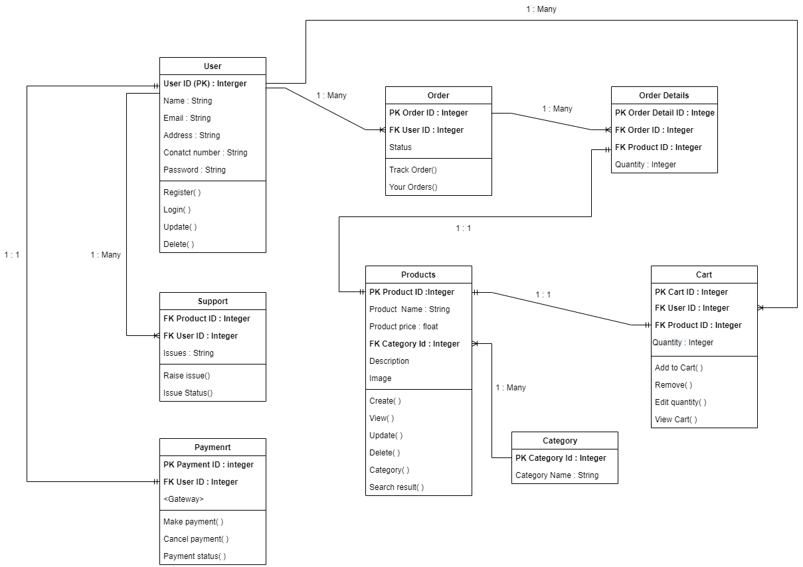

Slide 3


